Slide 1
Understanding Student Management System Code
Explaining the functionality and structure of the code
Name
Shah Arya – 22BT04133
Shah Hemal – 22BT04134
Shukla Prabhat – 22BT04141

Slide 2
Introduction
The Student Management System (SMS) is a software application designed to streamline the management of student-related information within an educational institution. It encompasses various functionalities, including student registration, enrollment, attendance tracking, academic performance monitoring, and administrative tasks. The primary goal of an SMS is to automate and simplify the processes involved in managing student data, thereby enhancing efficiency and organization within the educational institution.
The code we'll be discussing is a Python-based implementation of a Student Management System. It utilizes the Tkinter library for building the graphical user interface (GUI) and interacts with a MySQL database to store and manage student data. The code covers functionalities such as adding, updating, searching, and deleting student records, as well as exporting data to a CSV file.

Slide 3
Functions Overview
iexit(): Function to exit the application
export_data(): Function to export data to a CSV file
toplevel_data(): Function to create a popup window for adding, updating, or searching for student data
update_data(): Function to update student data
delete_student(): Function to delete a student record
search_data(): Function to search for student data
add_data(): Function to add new student data
connect_database(): Function to connect to the database

Slide 4
Database Structure
Table: student
Columns: id, name, mobile, email, address, gender, DOB, date, time
GUI Overview
Overview of the graphical user interface (GUI) components:
Main window layout
Buttons for various actions (Add Student, Search, Delete, Update, etc.)
Treeview widget for displaying student data

Slide 5
Code Walkthrough
Step-by-step walkthrough of the code:
Connection to the database
Definition of GUI elements (buttons, labels, entry fields)
Definition of functions for various actions (add, update, delete, search)
Configuration of the Treeview widget for displaying student data

Slide 6
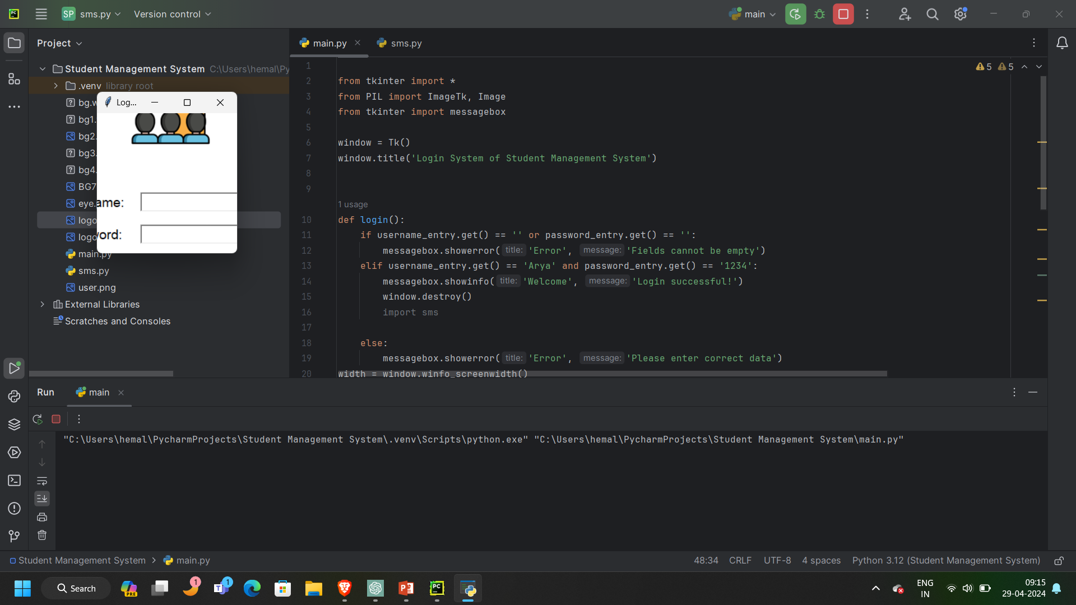
Demo

Slide 7
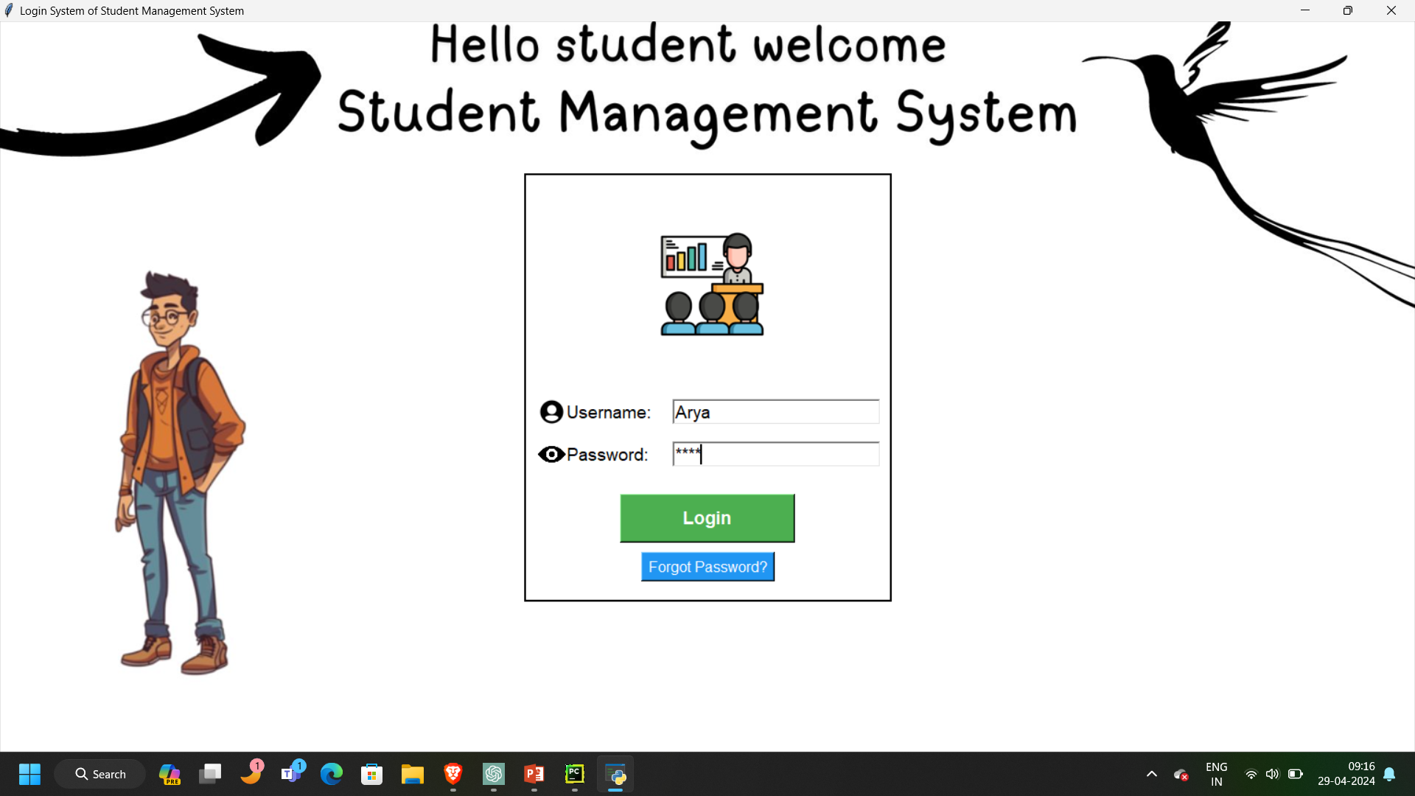

Slide 8
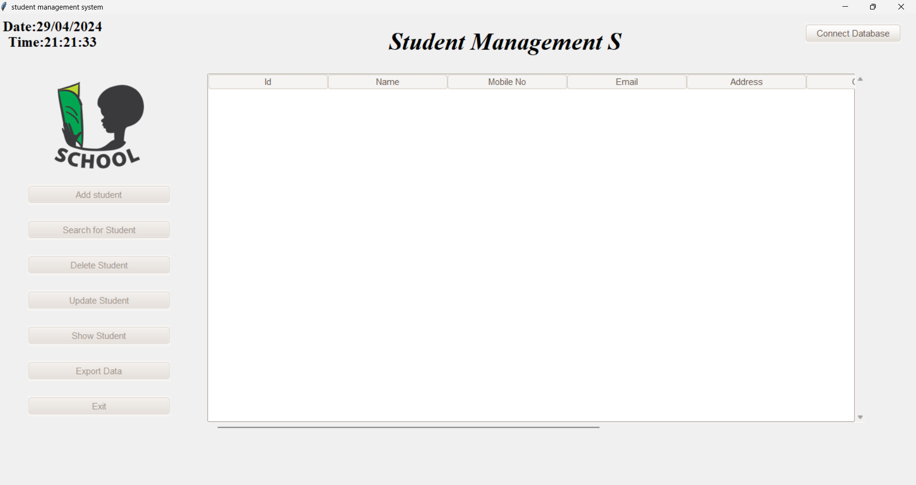

Slide 9
Conclusion
In conclusion, the Student Management System (SMS) presented in the provided code offers a comprehensive solution for educational institutions to efficiently manage student-related information. By leveraging Python programming and Tkinter for the graphical interface, along with MySQL for database management, the system enables users to perform essential tasks such as adding, updating, searching, and deleting student records seamlessly.

